Slide 1

Dynamic Flight Fare Tracker with Weather Forecast
Data Integration Project
- Rahul Yerramsetti

Slide 2
Introduction
Dynamic Flight Fare Tracker is a real-time flight fare monitoring application.
It also provides the real-time Hourly Weather forecast at the destination airport.
This is an Indian version of the Application.

Slide 3
Data Sources
Dynamic Flight Fare Tracker
Goibibo.com
Yatra..com
World Weather.com

Slide 4
Local Schema Goibibo API
fi(origin, rating, DepartureTime, flightcode, Group, farebasis, CINFO, deptime, duration, platingcarrier, flightno, destination, stops, carrierid, CabinClass, warnings, ArrivalTime, aircraftType, internationalsearch, splitduration, airline)

Slide 5
Local Schema Yatra API
fin(Dapt, Aapt, Yan, Tf, Dt, At, Fl,mac,yac,dd)

Slide 6
Local Schema-worldweatheronline
finalweather(query,date,maxtempC, maxtempF, mintempF, mintempC, uvIndex, time, hourly, tempC, tempF, windspeedMiles, windspeedKmph, winddirDegree, weatherCode, weatherIconUrl, weatherDesc, precipMM, humidity, visibility, pressure, cloudcover, HeatIndexC, HeatIndexF, DewPointC, DewPointF, WindChillC, WindChillF, WindGustMiles, WindGustKmph, FeelsLikeC, chanceofrain, chanceofremdry, chanceofsunshine, chanceoffrost, chanceoffog, chanceofsnow, chanceofthunder)

Slide 7
Global Schema
Flightinfo(Fcode, Source, Destination,Finfo,Fare, Sat, Dat, Apiinfo)
FinalWaether(Destination,Hourly, TempF, WindspeedMiles, Humidity, Chanceofrain, Pressure, Visibility)

Slide 8

Project Demonstration

Slide 9
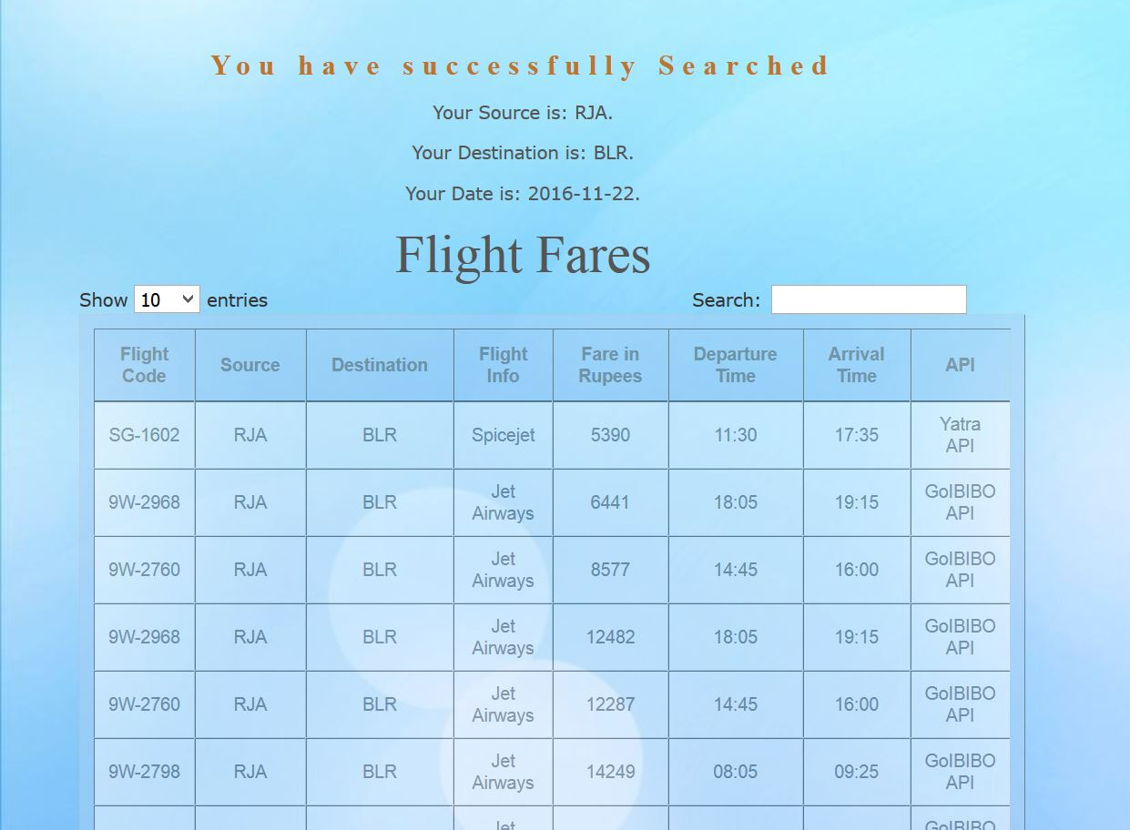

Slide 10
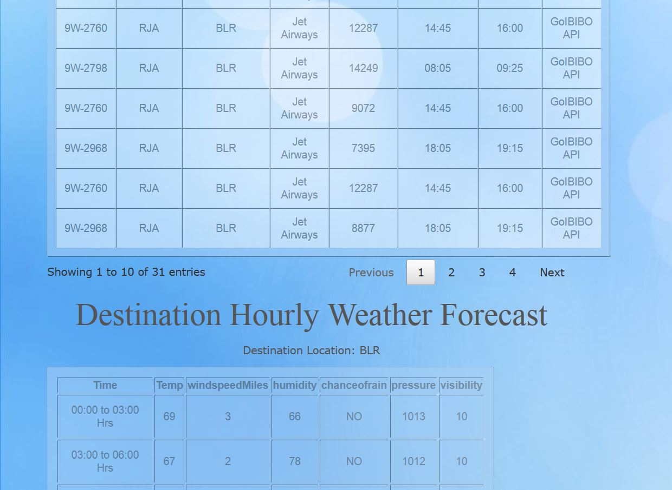

Slide 11
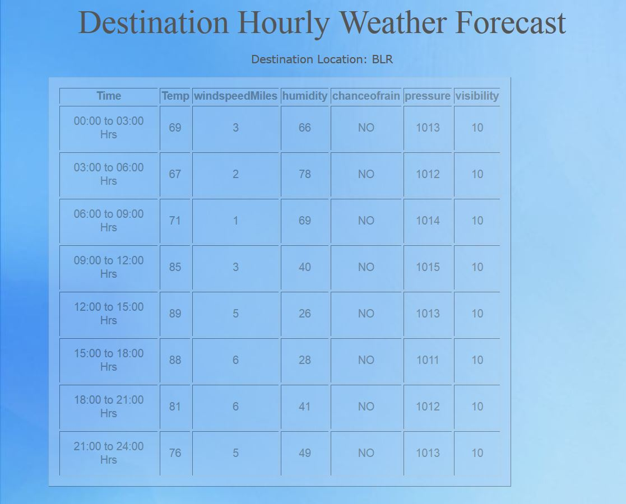

Slide 12
Have a happy and safe journey!!
Thank you

